Slide 1
Why IPR matters ?
Nalin Bharti
Professor of Economics and
IPR Chair Professor ,
Ministry of Commerce and Industry, Government of India (additional charge)
A presentation at the ITMU cell, ICAR-RCER ,Patna on 12 October 2023

Slide 2
The patent system adds "the fuel of interest to the fire of genius."
(Abraham Lincoln)

Slide 3

Introduction
Intellectual property (IP) is the creations of the human mind
The legal rights that protect these creation of minds are known as the Intellectual property rights (IPRs)
IPRs provide its owner the time-bound right to prevent others from using their intellectual property based on pre-defined and legalized criteria

Slide 4
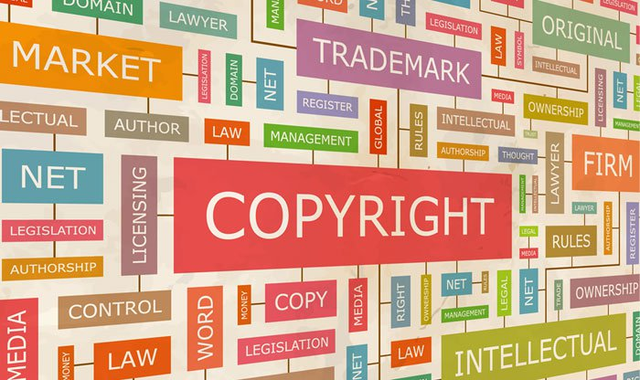
IPRs: two main areas
IPRs are normally separated into two main areas:
(a) Copyright and rights related to copyright
(b) Industrial property.

Slide 5
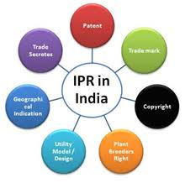
Seven Forms of IPR
Copyright and related rights (i.e. the rights of performers, producers of sound recordings and broadcasting organizations);
Trademarks including service marks;
Geographical indications (GI) including appellations of origin;
Industrial designs;
Patents including the protection of new varieties of plants;
The layout-designs of integrated circuits; and
Undisclosed information including trade secrets and test data

Slide 6
IPR Laws
Countries have laws to protect intellectual property for two main reasons
The first and foremost is to give legal interpretation to the moral and economic rights of creators for their creations and the rights of the public in access and use to those creations
The second is to encourage creativity and the diffusion and application of its results and to support fair trading which would advance to economic and social development

Slide 7
IPR and Innovation
Effective protection of IPR is an essential goal of the government for encouraging innovation
Innovation normally desires considerable investments in education, R&D, and labor for bringing new ideas to the marketplace
Depriving the innovators' ability to recover the cost of the investments in innovation, there will be very less incentive for the creators

Slide 8
Patents and Innovation
Patents safeguard inventions and innovations such as new drugs, industrial products, industrial designs, manufacturing processes, high-tech products, and chemical compounds, etc.
Economic incentive is granted through patents for taking risks and time involved in R&D
Public receives the benefit of that invention
Strong IP protection will not only encourage innovation, but it also provide confidence in an economy that will help in attracting FDI and ensures technology transfer

Slide 9
Benefits of Strong Patent Framework
Sr. No. | Benefits of Patents
1 | Helps in increasing global trade and commerce
2 | Stimulate more FDI
3 | Granting of new patents increases local production
4 | Lead to higher growth and economic development

Slide 10
IPR and Trade
Safeguard and enforcement of IP is crucial for a country’s ability to stimulate innovation and to compete in the global trading environment
IPR support creativity, innovation and invention, that is essential for manufacturing of new products
This facilitates trade by introducing new product in the global market

Slide 11
IPR and Trade
Some examples:
74% of all U.S. exports is based on the intellectual property ----this is almost 1 trillion dollars
Mega FTAs like Trans-Pacific Partnership (TPP) Agreement will promote free trade, but IPRs are crucial under these negotiations

Slide 12
COPYRIGHTS AND CULTURE
IP protection serves ends like cultural development and preservation, as well as economic and social well- being
Local cultures can be at risk without strong copyrights protection
Artistic works by local and indigenous people, authors, musicians, and others must be supported by the legal framework and enforcement
Illegal sale of cheap or free music, movies, and books can be strongly prohibited to protect local culture

Slide 13
BUSINESS AND CONSUMER PROTECTION
Products are identified and differentiated from others on the basis of trademarks
It serves as an indicator of the quality of products
Spurious and illegal use of a trademarks cheat consumers and guarantee of quality and accountability of products is completely lost in this process
Health and safety of the people too is threatened due to counterfeit trademarks

Slide 14
CONSUMER PROTECTION
Enforcement of IPR can facilitate consumers in making well-informed selection about the protection, trustworthiness, and efficacy of the purchases
IPR promote assurance that consumers demand and producers supply is in equilibrium in the markets

Slide 15
IP AND SOCIETY
It has become very essential to remind the role of IP protection in our day-to-day life
More specifically in the developing world, counterfeit pharmaceuticals have become a severe and fatal problem around the globe
This is very serious issue and thus for the protection of the society strong IPR is needed
Associated issues like plant variety protection, bio-piracy, cloning, genetic modification, genetic engineering, etc. ---need strong IPR protection

Slide 16
IPR and global challenges
Sr. No. | Challenges | Solutions
1 | Health/Medicines | About 300 drugs came under the WHO’s Essential Drug List are the outcome of intensive research and development are backed by patent protection
2 | Agriculture | Ground-breaking agro- based companies are innovating new products and new seeds to facilitate farmers to produce more to alleviate global hunger and malnutrition
3 | Environment | Innovation in non-conventional energy and green technologies can help in improving the energy security and tackle the issue of climate change with the help of intellectual property

Slide 17
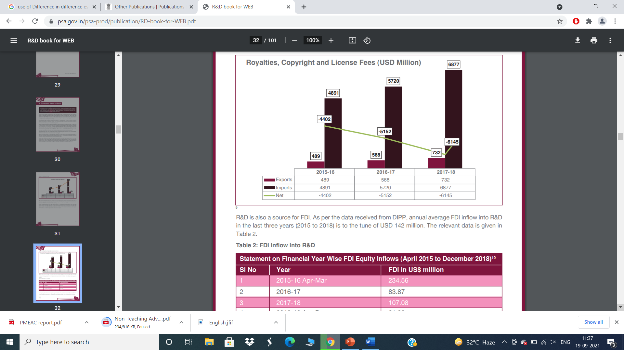
According to United Nations Educational, Scientific and Cultural Organisation (UNESCO) Institute for Statistics, India is amongst the top ten R&D spenders in the world, i.e. $48.1 bn R&D spending (adjusted for PPP) constituting 2.7% of the global share ( 2020).
The below figure indicates that India is a net importer of IPs (Source- PMEAC 2020)
Number of Patents Granted is low compared to Brazil, China.

Slide 18
Industry-Academia linkages
Industrially relevant knowledge and skills at affordable cost has become more significant in the globalised world
The present condition of the industry–University/Academia/Research & Development institutions linkages in India is not strong enough to cater the needs of the globe
For the larger interests of the nations and to increase the competitiveness of the global industry, there remain several institutional bottlenecks

Slide 19
IPR and Employment
IP generates and supports high-paid employments
More than 55 million people are getting employment in intellectual property -based industries in the United States
Estimates show that the normal worker in the IP-based industry in US be paid some 30% more than a non-IP industry worker

Slide 20
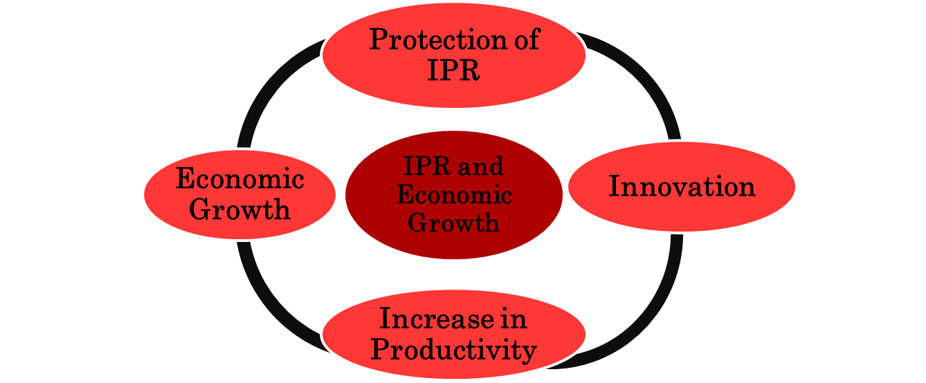
IPR and Economic Growth
For more details watch the video: https://www.youtube.com/watch?v=gmu485kpwEY

Slide 21
IPR and economic growth & competitiveness
The importance of intellectual property can be traced through some instances : IP industries account for 38.2% of the total GDP of the U.S. and for almost ¾ of the U.S.'s exports; America's intellectual property accounts for $6.6 trillion in added value.
Moreover, share of US’s intellectual property based industries is 38% of the GDP
Likewise, more than 40% of the United States economic growth and employment have the direct or indirect effects of innovation and inventions

Slide 22
Concluding observations
IPR provides strong incentives for innovation and inventions
Convert innovative ideas, creative designs, and other intangible assets into valuable business assets
IPR is integral to the rule of law and good governance and it promotes public health, food safety and safety by combating fake goods and ensures quality of products.
Institutions like ICAR with other institutions in Bihar can also come up with more patent applications and make the journey of IPR in India more fast.

Slide 23
Weightage Distributions
Activities | Weightage
Quiz 1 | 5
Mid Sem | 20
Quiz 2 | 5
Lab Assignments | 20
End Sem | 50

Slide 24
Thank You

